Slide 1
ICE Surveys
Mr. Greg Dangremond
December 7, 2021

Slide 2
4th Quarter
Solicited Surveys | JUL |  |  | AUG |  |  | SEP |  |  |  | 4th Qtr
Business Area | Sent | Resp | CSAT | Sent | Resp | CSAT | Sent | Resp | CSAT | Sent | Resp | CSAT
RTD | 337 | 15.4% | 95.2% | 360 | 6.3% | 95.6% | 309 | 14.5% | 93.3% | 1011 | 11.8% | 95%
LESO | 57 | 45.6% | 100% | 47 | 93.6% | 100% | 142 | 86.6% | 97.5% | 246 | 78.4% | 98.4%
Turn-in/Receiving | 601 | 15.9% | 94.7% | 588 | 18.7% | 95.4% | 560 | 26.4% | 96.1% | 1763 | 20.0% | 95.7%
Transportation | 346 | 18.7% | 95.3% | 345 | 15% | 98% | 377 | 24.1% | 96.6% | 1072 | 19.4% | 96.6%
Hazardous Waste | 29 | 27.5% | 87.5% | 30 | 20% | 100% | 71 | 7.0% | 20.0% | 135 | 14.0% | 73.6%
TOTALS: | 1370 | 256 / 268 | 95.5% | 1370 | 228 / 235 | 97% | 1459 | 243 / 251 | 96.8% | 4227 | 727 / 754 | 96.4%
Response Rate | 19.5% |  |  | 17.1% |  |  | 17.2% |  |  | 17.8% | 13.3%
Response Rate Goal is 16%
16% and above
15%-11%
10%-0%
Satisfaction Goal is 90%
100%-90%
89%-70%
69– 0%
As of 10 November 2021
Notes:
Updated: November 10, 2021 Data Source: Interactive Customer Evaluation (ICE) website
Customer Satisfaction (CSAT) industry standard formula is positive responses divided by total responses (not including N/A)
Examples of businesses with high American Customer Satisfaction Index (ACSI) ratings; Chick-fil-A (86), Aldi (85), Amazon (84), CostCo (84), Toyota (84)
Industry benchmarks; global average for all industries worldwide is 86%
Industry average response rate is between 10 and 15 percent for external surveys. (SurveyGizmo)
Our monthly surveys solicit responses from five specific targeted Business Areas; RTD, LESO, Transportation, Turn-in and Receiving, and HW.
Customer Initiated Responses are unsolicited random customer initiated surveys frequently used in place of the Business Area Survey.
Example Transportation comment; “Worst experience with schedule pick up of equipment. Three times, my team was ready for pick up on a date/time told to us and three times, no one showed up. Only on the fourth try did the equipment get picked up.”
(Knox)
Example Turn-In and Receiving yellow comment: “we set up an appointment to remove property and they wouldn't load the driver because they didn't have the paperwork from whomever. literally no one will answer a phone call and 2 out of the 3 don't have a voice mailbox that is set up. if this is supposed to be a service they greatly and epically failed.” (San Antonio)

Slide 3
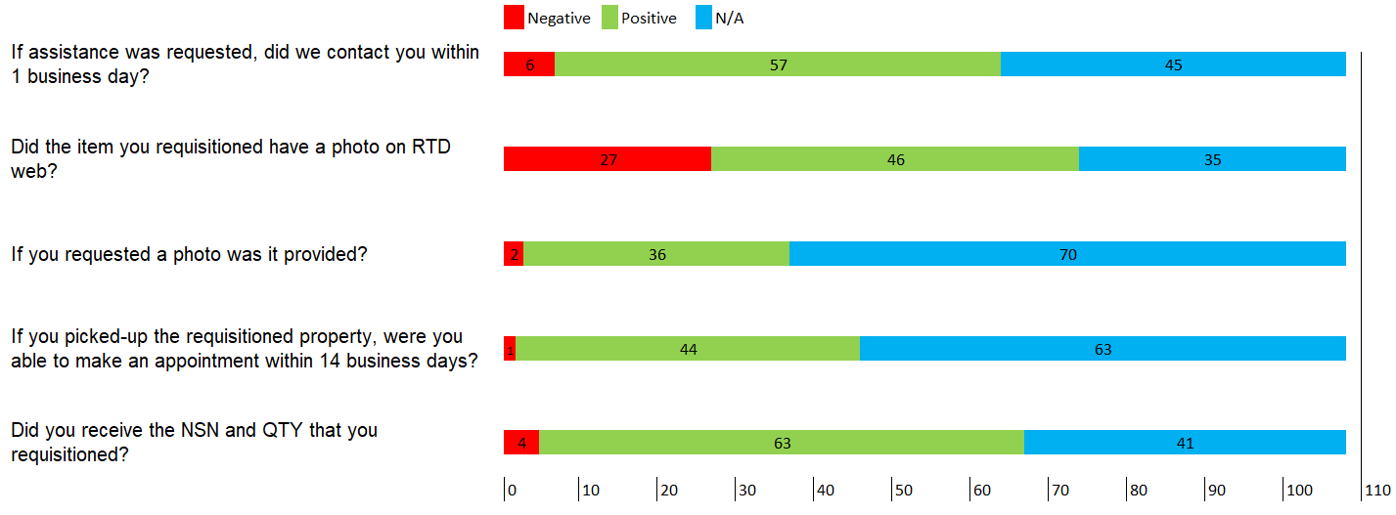
RTD
Customer Feedback
More photos on RTD Web
LSN’s (made up)
Employee compliment
OPR/Action
RTD working with field to load more photos
Negative responses to questions will be publicized to Business Area/DSD
Comments
“All items listed on the RTD website should have a picture posted”
“Please take more photos of current inventory”
“DLA website is great when I can login.”
Notes:
Sample Comments:
“Site RTD specialist was not prepared and was not expecting me after confirmation of appointment by email. Acted as if they did not know what they were doing”
(No site listed)
“In Feb 2020 I was awarded a small craft boat from DLA disposition services Charleston AFB - the DLA site was responsive regarding award and pickup. I however have requested a certificate for title multiple times via email and by leaving phone messages. No one will respond to my email requests or phone messages. This has been well over a year of trying to obtain a certificate for the title and I have yet to receive a response to any of my multiple emails or phone calls. I am very disappointed and frustrated with the customer service from this DLA site. I have had to ask another DLA site for a certificate of title which I am still waiting on. I would like to know how to obtain the certificate for a title for this item. I am more than happy to share the number of emails I have sent to this DLA site requesting assistance. Thank you”
(No site listed)

Slide 4
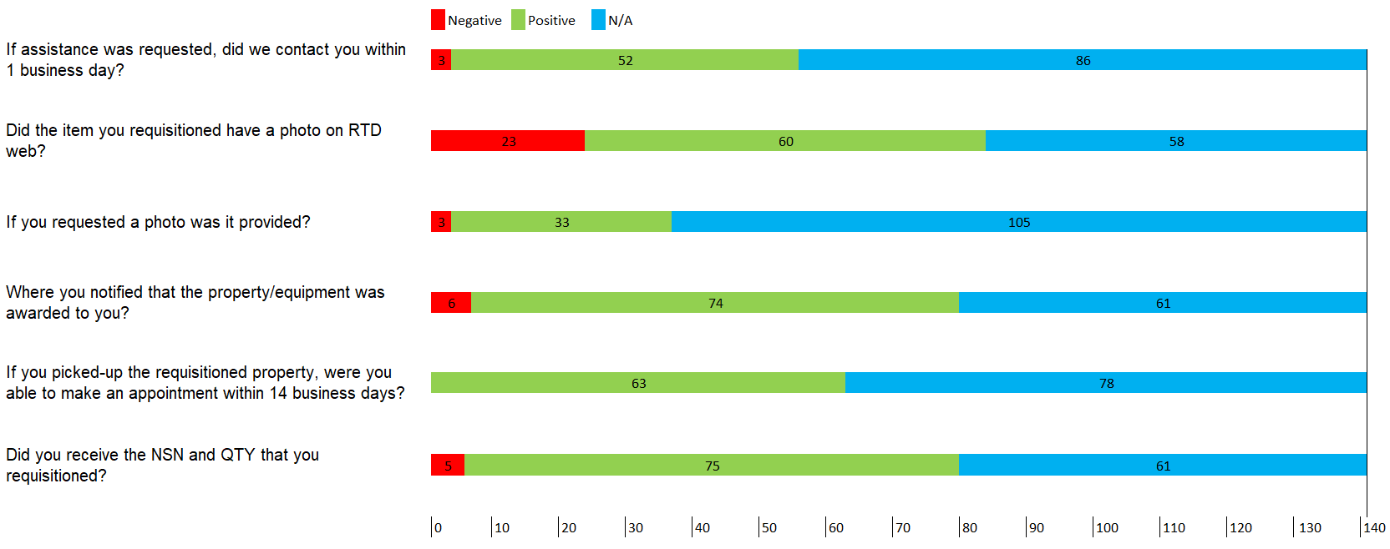
LESO
Customer Feedback
More photos on RTD Web
Website difficulties
Employee compliment
OPR/Action
RTD working with field to load more photos
Comments
“Some items had pictures and some did not”
“Clothing sizes would be nice. Please take more photos of current inventory”
Update the Security Certificate on the DLA website!!
Notes:
Sample Comments:
“All items listed on the RTD website should have a picture posted. Rolling stock should included if the vehicle is able to be driven.” (No site mentioned)
“provide pictures for all items for initial post to allow for quicker requisition of materials, instead of waiting days for a response and updated post..”(Columbus)
“Warner Robins DLA has continuously disregarded pickup emails, emails for requests on more information, coordinating scheduled removals and has provided nothing but radio silence for the many times that we have initiated contact; at the lesat, put an out of office message on or something. This has gotten so bad that we have decided to disregard Warner Robins DLA when screening for viable property options on GSAXcess, as it is too much of a headache. Other bases such as Camp Lejeune, Fort Benning, Eglin and Fort Bragg are far more positive experiences,”

Slide 5
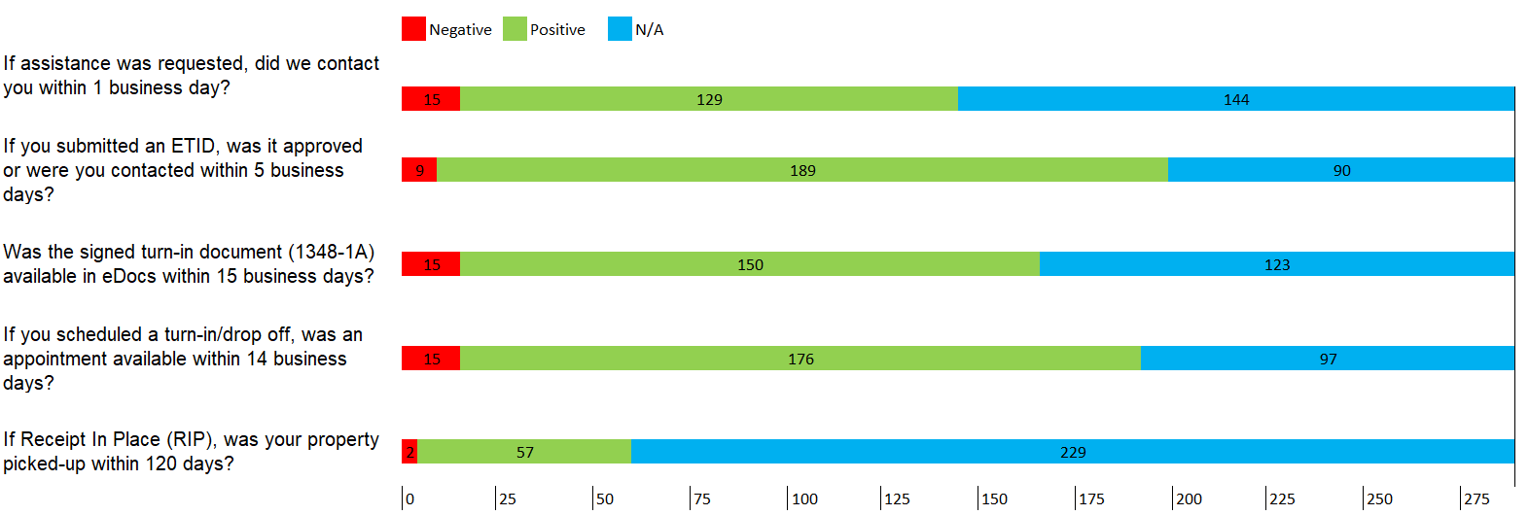
Turn-In/Receiving
Customer Feedback
eDocs not uploaded in a timely manner
Hard to get an appointment or times not being met
Employee compliment
OPR/Action
Comments sent to appropriate Site/DSD
Revisit RIP question
Comments
“Waited nearly 2 hours. ”
“Appointment was set for a certain time but did not complete until 2 hours later.”
“I always get good service from DLA thanks for your support”
Notes:
Sample Comments:
“Waited nearly 2 hours.
When scanning my 1380's to submit, the ink is barley visible on the document. Not great as far as proof goes that the item has been turned in.
Was serviced by Mr. David Monroe. Once it was my turn, he immediately came to me and assisted with the turn in and signing of documents. Seemed very knowledgeable, double checked my paperwork and even had me re-check the documents to make sure everything was stamped. Had me in and out in no time.
Thanks David (Pendleton)
“DLA DISTRIBUTION ANNISTON- Call again today at 10:36am nothing and been calling since 8am here Eastern time. I am aware they are 1 hour behind us but all4 out of 5 number and no one picks up. and the 5th number is completed disconnected. Emails has been send out by Transportation to all who is on the list as POC. again Nothing. not sure what is the issue but customer services needs to react while equipment is needed to be turn in. I know my Truck driver called for some other equipment's that needs to be turn in but again it took days for someone to answer back and give a good to received equipment. this is one of the location that give me issues and my supporting Unit's. I address all my Unit's to starts using these survey and enter their comment and concerns to help improve our communication better for all work related or business that occur with helping support the military requirements. Please read below.
Trans Office Rejected REACHED OUT TO UNIT ON 7 MAY 21 FOR LAST ATTEMPT, STILL NO RESPONSE.
REACHED OUT TO UNIT, NO RESPONSE. 5 MAY 21
USARC Approved REACHED OUT TO UNIT, NO RESPONSE. 3 MAY 21 (Anniton)
“At times after an event is scheduled there have been times where an event was never acknowledged for date requested. Also, is there a mechanism where I can query any or all of my scheduled events on the exact status of its outcome? The only options I see is once the event is scheduled it can be:
- approved
- cancelled
- no acknowledgement
- walk-ins are allowed as time requires at the DLA/DRMO site” (San Diego)

Slide 6
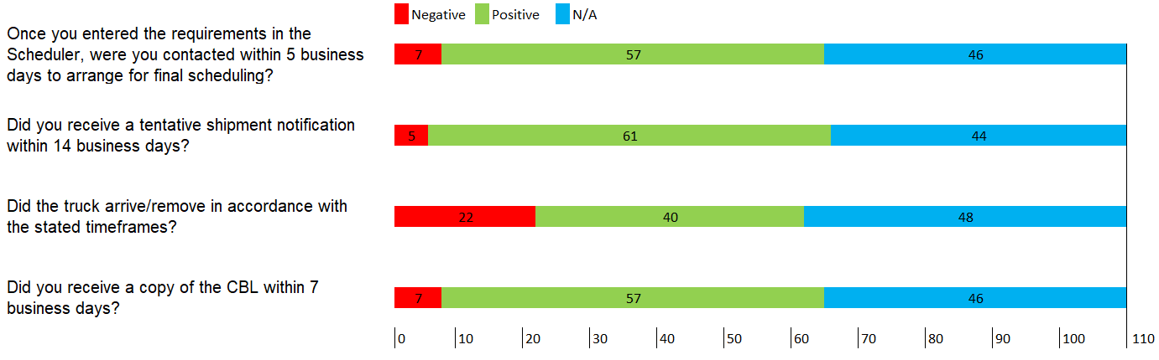
Transportation
Customer Feedback
Truck No – shows/Late trucks
Poor carrier performance
Access getting on base
OPR/Action
Transportation office working to resolve repeat offenders
Transportation personnel added as ICE Managers for situational awareness
Comments
“Contract drivers that are reliable. Wasted our time on two different occasions.”
“2/3 Trucks showed up I requested a truck and it never showed”
“The overall experience was good”
Notes:
Sample comments:
“DLA trucks have been requested to pick up DLA property at Whiteman AFB. Of the last 2 months there have been at least 3 no shows without follow up to see if the trucks have arrived. We not receive follow up communication on a carrier's status for property pickup. CRST Inc and PSALMS Freight carriers recently failed to provide trucks when scheduled bye the DLA scheduler and without being able to recover the scheduled property pick up 10 days from the original scheduled request. Please advise with ongoing issues with DLA communication” (Whiteman)
Sample Comments:
“I have been working with Mr. Hines to get a truck to pick up a load of scrap tires since 30 Mar. The original carrier failed to pick up the load multiple times. A new carrier was scheduled and they have also failed to pick up the load. I'm waiting on further contact from Mr. Hines for a new date. Also, if anybody can give me a phone # or website address, I'm curious to see what it takes for a carrier to be put on a list to where they can pick loads up” (HQ Battle Creek)
“2/3 Trucks showed up I requested a truck and it never showed. I requested a second truck and that one never showed, I requested a third truck and I have not heard back from them. Still till this day I am waiting a on a recovery truck”

Slide 7
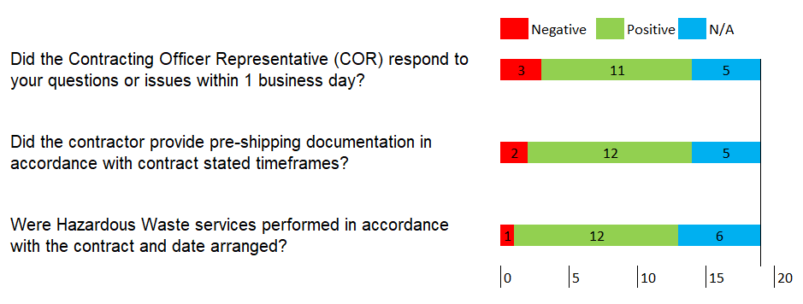
Hazardous Waste
Customer Feedback
COR responsiveness
Limited (does not give us a real picture; less than 25 respondents
OPR/Action
HMMS does require customer contact data
Environmental working to improve customer outreach
Comments
“Do not relocate the on-site COR”
“This leadership and staff have set the standard for customer support and satisfaction. No improvements needed!”
Notes:
Sample Comments:
“The fact that DLA software systems require valid DODAAC's from the generator doesn't make sense to me when all that should be significant is the physical address of the waste to be picked up. North Carolina has sites that do not have valid dodaacs and/or changing dodaacs over many years and turn-in processes have been held up, disconnected, and cancelled because of it. I think the easiest fix is to create the field as option and not required. obligate it is as a dummy field if need be to fill a process but bumping it against other systems that cannot even provide a correct dodaac for a specific site is working in reverse” (Bragg)

Slide 8
Unsolicited Comments
Unsolicited Surveys | APR |  | MAY |  | JUN |  | 3rd Qtr
 | Resp | CSAT | Resp | CSAT | Resp | CSAT | Resp | CSAT
Customer Initiated Responses | 21 | 95.2% | 26 | 100% | 12 | 100% | 65 | 98.4%
Satisfaction Goal is 90%
100%-90%
89%-70%
69– 0%
Frustrated with the
“DRMO process”
Difficulty reaching sites by phone and email
Scheduled trucks fail to arrive or arrive late
Poor customer service
Employee compliment x2

